Slide 1
Week 12 Lecture No. 23
Visual Programming C# & .Net Framework
Course Instructor: Dr. Malik Daler Ali Awan
01/10

Slide 2
Topic
Connecting Database
Inserting Data Into Table
02/10

Slide 3
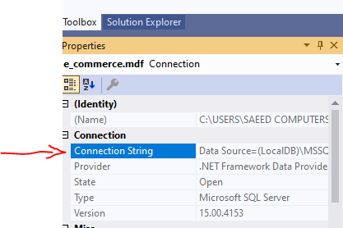
Database Connection
How to create connection?
Assuming that , database and tables are have been already created. Because we have already discussed it in previous lectures.
Steps
Go to sever Explorer
Click on the Database Name
Looking into Property Section
Copy the connection String
03/10

Slide 4
Database Connection (Continue)
Import Library (using System.Data.SqlClient;)
Create connection object using “SqlConnection” Class.
Paste the copied string and write “@” before it. (See the code snip given bellow)
Check the “Double Quotations” as given in code below in your pasted string.
SqlConnection conn = new SqlConnection(@"Data Source=(LocalDB)\MSSQLLocalDB;AttachDbFilename=""C:\Users\SAEED COMPUTERS\OneDrive\Documents\e_commerce.mdf"";Integrated Security=True;Connect Timeout=30");
04/10

Slide 5
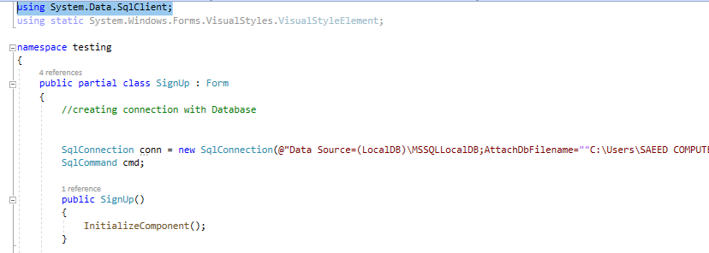
Database Connection (Continue )
Create cmd object to communication with database using “SqlCommand” Class
05/10

Slide 6

Checking Connection
Write the open() method to open the connection with database.
Using MessageBox.Show ( ) , method to confirm the connection is opened.
06/10

Slide 7
Inserting Data in a Table
Create new object of SqlCommand class,
Write the query
Use correct field name of table
Use the correct name of input box.
Must use the conn object to connect with database.
07/10

Slide 8

Command Execution
08/10

Slide 9
Class Activity
Write more fields and Insert the data.
09/10

Slide 10
Thank you!
10/10

